Slide 1



Kris Gates
gates@healthendeavors.com

Slide 2


FHIR or API
BOT
The Fast Healthcare Interoperability Resources (FHIR) standard is a set of rules and specifications for exchanging electronic health care data. It is designed to be flexible and adaptable, so that it can be used in a wide range of settings and with different health care information systems.
EHR Application Program Interfaces (API) may achieve the same purpose.
Software program that performs automated, repetitive, pre-defined tasks by interaction with systems and users. Bots typically imitate or replace human user behavior.

Slide 3

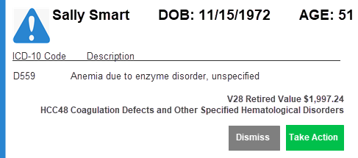
EHR Notifications

Slide 4
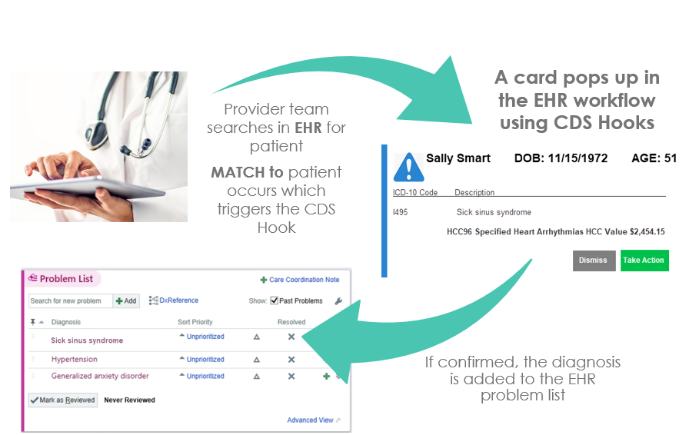

Slide 5


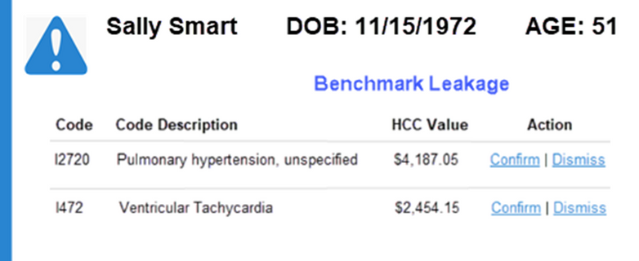
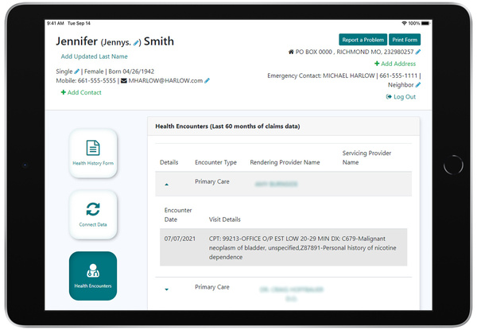
Virtual Performance
Outcomes Plan (vPOP)
Pop ups or Tabs
  Claims Data
    Medicare
    Medicaid
    Medicare Advantage
    Commercial
    Self-Insured Employer
    TPA
  Device Data
  Consumer Input
  EHR Clinical
    QRDA
    FHIR
    HL7 Lab
    ADT
FHIR Health History
Data Sources

Slide 6

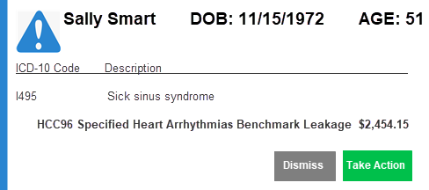
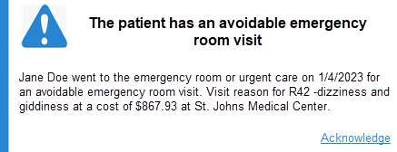
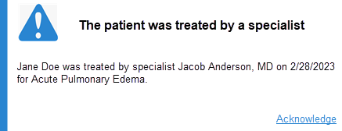
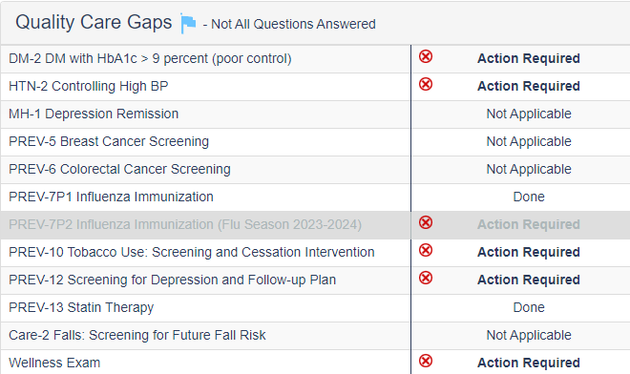
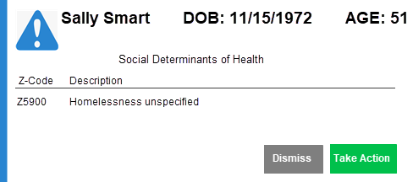
Types of FHIR BOT Notifications
HCC Coding
Cost Reduction
Quality
Health Equity

Slide 7

Phases to Launch
Explore
Plan
Installation
Go Live
EXPLORE EHR CAPABILITIES
PLAN THE NOTIFICATIONS
INSTALL FHIR BOTS SOLUTION IN EHR
  SELECT GO LIVE DATE
  CONDUCT TRAINING

Slide 8

EHR Notifications Connectivity Integration Options
Different EHRs will have different capabilities. EHRs with Clinical Decision Support (CDS) Hooks allow cards to pop up in the EHR patient workflow while other EHRs rely on their Application Program Interface (API) functionality to display data in the EHR on a tab in the patient chart that may or may not pop up. Both capabilities offer the ability for actionable data in the EHR workflow.
CDS Hooks (HL7) Card (pop up) on Patient Chart | EHR API Tab or Pop Up on Patient Chart | SMART on FHIR
Decision support in the form of cards may display as part of the provider workflow. Cards may be informational or allow the user to accept or reject the prompted action. Cards or CDS Hooks may be customizable if installed as distinct products or the practice is identifiable by an id number. An event, such as the loading of a patient's chart triggers the CDS service logic to serve up a card or cards in the EHR workflow with actionable information for the provider team. | Proprietary EHR Application Program Interface (API) facilitates selected data elements to render on a tab on the patient chart. If your EHR has an API then a tab on the patient chart in the EHR renders with the actionable data. The EHR may have the option to popup the tab into the workflow. Depending on the EHR API without SMART on FHIR it may have either: Read capabilities Read/Write capabilities Most EHR APIs only have the ability to read and not write. Tabs can be customized as the Practice ID of the EHR is identifiable and is passed back to Health Endeavors in the API process. | SMART on FHIR capabilities means data has read or write. capabilities SMART on FHIR defines a workflow that an application can use to securely request access to data, and then receive and use that data. Read means the ability to pull or extract EHR data or claims data and display on the card. Write means the ability to push or import EHR data from the card to the EHR or another repository.

Slide 9

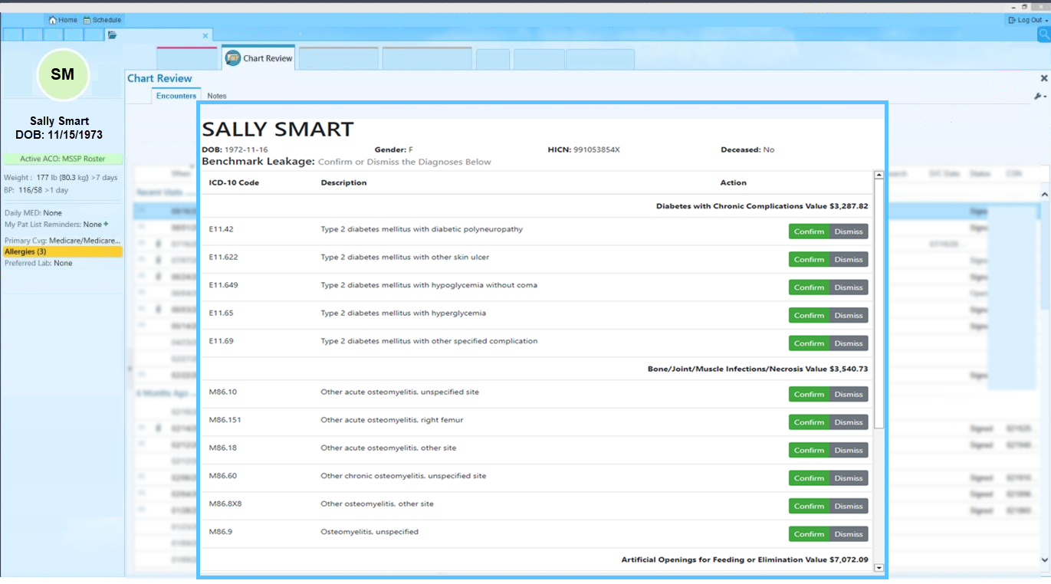

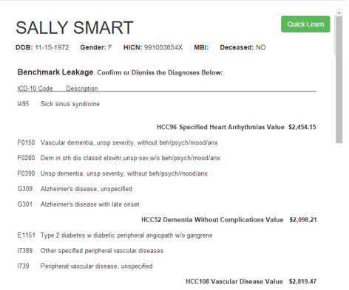

Customizable Card or
Tab Generates
EHR Connects to FHIR BOTS Application to locate patient
EHR User Searches for Patient

Slide 10


Pop-Up Card
Customizable pop-up card in the EHR using CDS hooks and SMART on FHIR.
Clinical Decision Support (CDS) Hooks: configurable data cards that may popup in EHR workflow.
Fast Healthcare Interoperability Resources (FHIR):platform to push/pull data from or to the EHR and other data repositories.
vPOP card (CDS Hook) is an EHR notification. Upon locating and opening a patient chart, the notification will “pop-up” to notify your clinical team when a data point needs attention or action.

Slide 11

HEALTH ENDEAVORS
Tab in EHR
Customizable tab in the EHR proprietary Application Program Interface (API).
Proprietary Application Program Interface (API) to populate a tab on the patient chart with configurable data points.
vPOP Tab are a list of notifications on a tab that are applicable to a patient. Upon locating and opening a patient chart, the notifications applicable to the patient will display on a clickable tab to notify your clinical team when a data point needs attention or action.

Slide 12
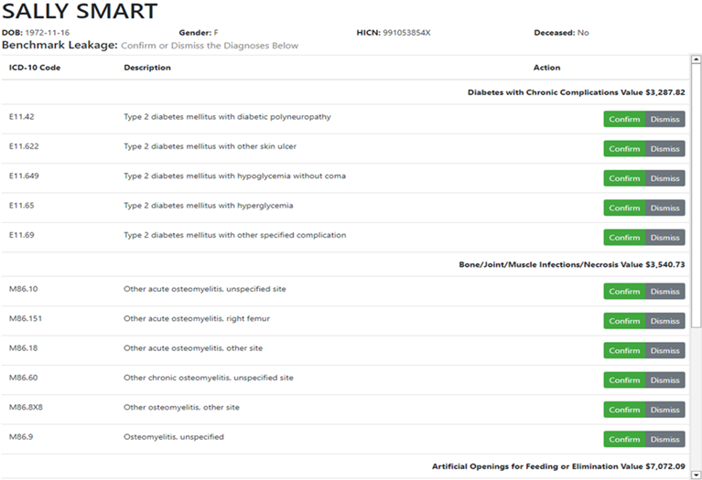
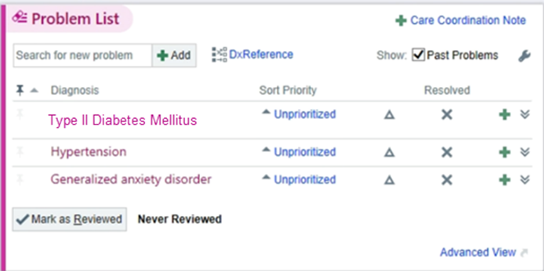
HEALTH ENDEAVORS
SMART on FHIR
SMART on FHIR or Fast Healthcare Interoperability Resources (FHIR) enable data to pushed/pulled to or from the EHR and other data repositories.
For example, with FHIR, a diagnosis may be pushed with a simple click of a button to the patient's problem list.

Slide 13


Slide 14

Cost Reduction
HCC Coding
Medications
SNFs
Avoidable Emergency Room Use
Recapture Rate
V28
Suspect
Medication NO Diagnosis
Not picked up
Medication NO Diagnosis
All prescriptions/all providers
Customizable
Quality Measures
Health Equity
Prompts to notify team of a health equity concern such as transportation for a patient.
Completely automate HEDIS and Medicare quality data collection.

Slide 15
FHIR BOTS Customization
  HCC Diagnosis Recapture: Notify EHR end user a HCC diagnosis code has not been re-coded in the current year by using a notification display of the value of the HCC diagnosis code. The purpose of this alert is to tackle the problem of Benchmark Leakage or loss to the Benchmark value due to failure to recode.
  V28 HCC Model Updates: Notify EHR end user a HCC diagnosis code has been retired or its value has changed. The purpose of this alert is to minimize the impact of the new V28 HCC Model to be implemented in 2024.
  Avoidable Emergency Room Encounter : Notify EHR end user the patient has utilized the emergency room for a non-urgent reason during that past 12 months. For example, an emergency encounter for a bladder infection.
  Prescription Not Picked Up: Notify EHR end user the patient has picked up at the pharmacy one time a maintenance medication but has not picked it up since.
  Advance Care Planning (ACP): Notify EHR end user if Advance Care Planning has been completed or not completed in current year for the patient. The value of ACP is $80 per Medicare patient.
  Spend Allowance Exceeded: Notify the EHR end user the patient's spend has exceeded their spend allowance.
  Quality Measures automatically pull from EHR into central repository for reporting to Medicare qualified registry.
  Health Equity: Notify EHR end user of the patient's social determinants of health such as food, transportation, or shelter issues.
  Out-of-Network: Notify the EHR end user if the patient is using Part B or Part A services out-of-network.
  Palliative Care Review: Notify the EHR end user if the patient has a terminal condition and is using the emergency room or hospitalizations for their care source.

Slide 16
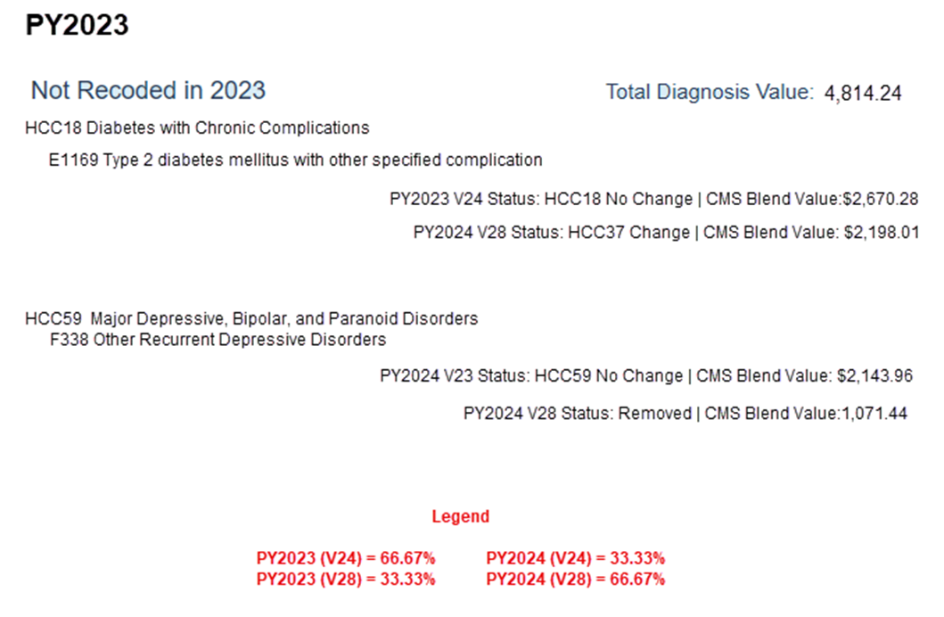

Slide 17
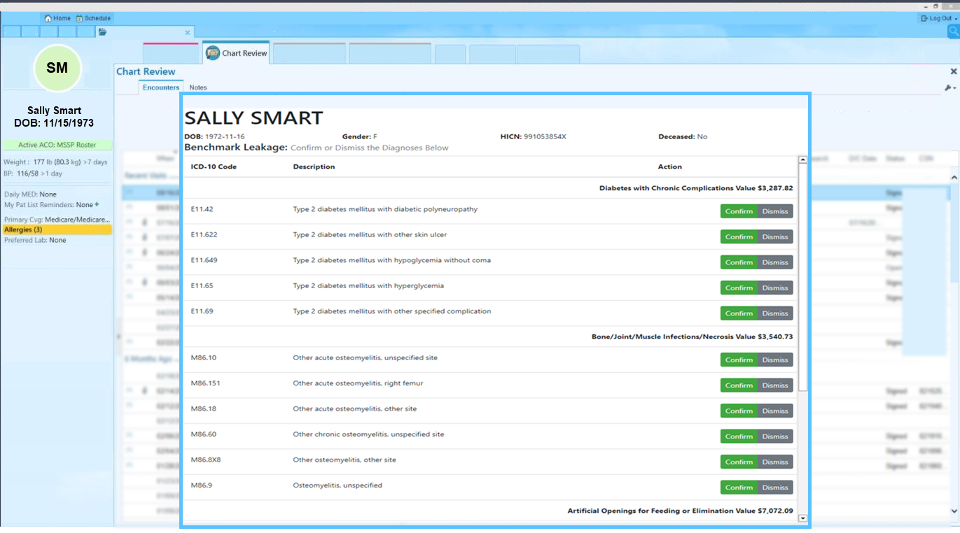

Slide 18



Slide 19
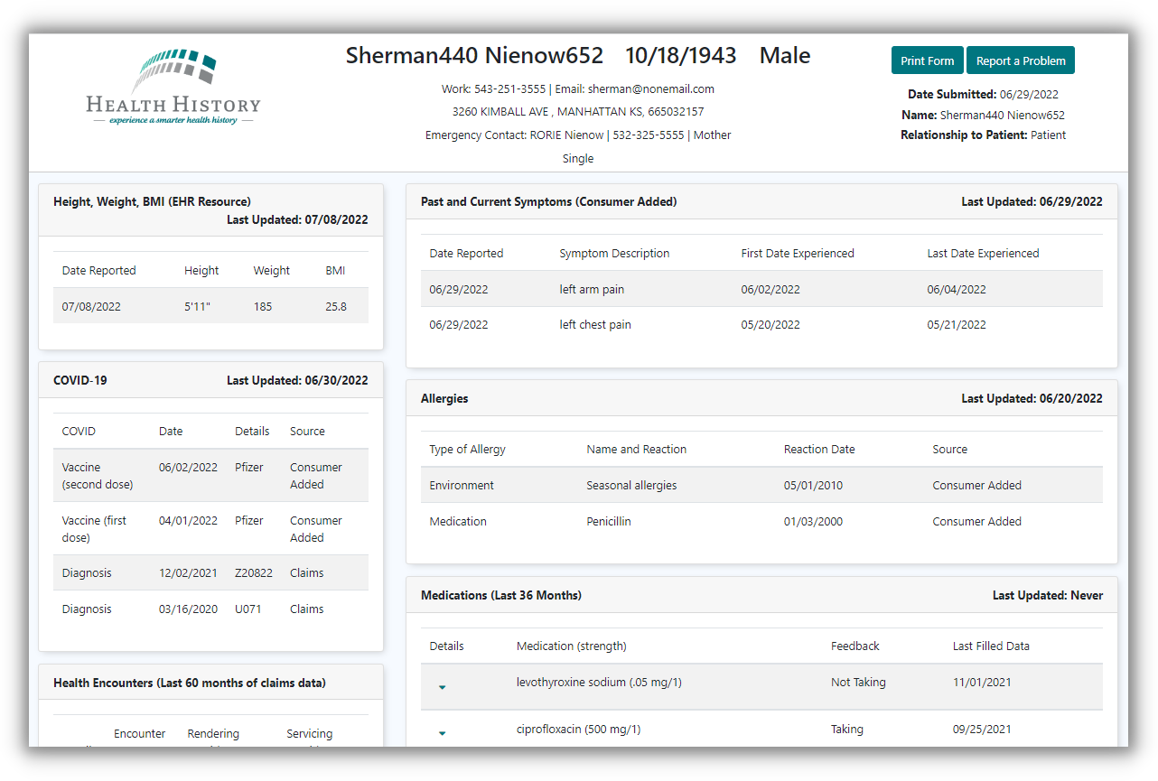

Slide 20
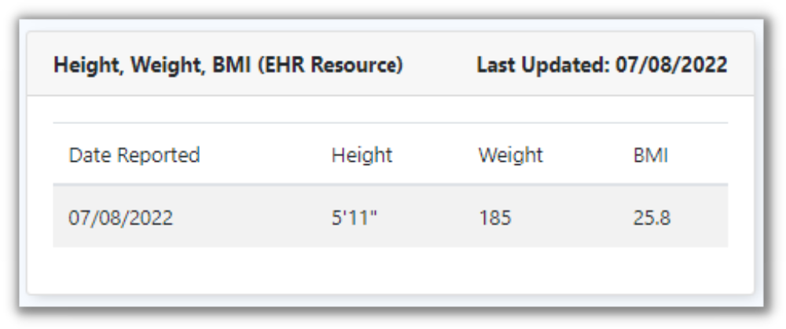
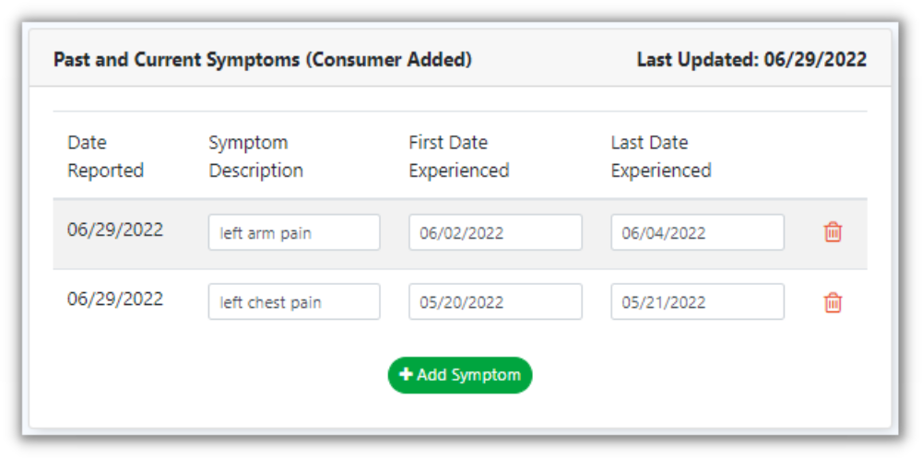
Height, Weight, and BMI

Slide 21


EHR
Epic
  Certified by ONC
  FHIR enabled or API enabled
  SMART on FHIR enabled or API enabled
Cerner
AthenaHealth
Allscripts
Any FHIR EHRs

Slide 22
Contact
KRIS GATES
HEALTH ENDEAVORS
Kris Gates
gates@healthendeavors.com

